Slide 1
Chapter 5 – Intro Pandas
2022-2023

Slide 2
Overview
Pandas – Jupyter
Series and DataFrame
Creating dataframes from scratch
Extracting and assigning data
Reading data from CSV and JSON
Basic dataframe operations
Column names cleanup
Missing values
Conditional selections

Slide 3

The most popular Python library for data analysis
Through pandas, you get acquainted with your data
Pandas helps you
calculate statistics and answer questions about the data, like
What's the average, median, max, or min of each column?
Does column A correlate to column B?
What does the distribution of data in column C look like?
clean the data by doing things like removing missing values and filtering rows or columns
visualize the data with help from Matplotlib (plot bars, lines, histograms, bubbles, …)
store the cleaned, transformed data back into a CSV, other file or database
pandas is derived from the term "panel data“ which are data sets that include observations over multiple time periods for the same individuals [Wikipedia]

Slide 4
Not only is the pandas library a central component of the data science toolkit but it is used in conjunction with other libraries.
Pandas is built on top of the NumPy package, meaning a lot of the structure of NumPy is used or replicated in Pandas. Data in pandas is often used to feed statistical analysis in SciPy, plotting functions from Matplotlib and SeaBorn, and machine learning algorithms in Scikit-learn.

Slide 5

Jupyter notebooks
Jupyter Notebooks offer a good environment for using pandas to do data exploration and modeling
Jupyter Notebooks give the ability to execute code in a particular cell as opposed to running the entire py file. This saves a lot of time when working with large datasets and complex transformations.
Notebooks also provide an easy way to visualize pandas’ DataFrames and plots.

Slide 6
Jupyter notebooks
Jupyter’s tools are available for installation via the Python Package Index, the leading repository of software created for the Python programming language
Install the classic Jupyter Notebook with this command in a terminal window:
pip install notebook
To run the Notebook use the command:
jupyter notebook

Slide 7
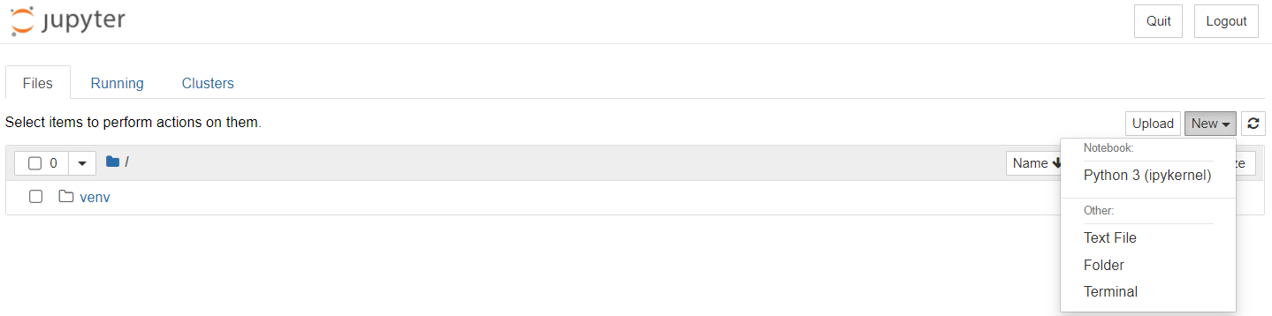
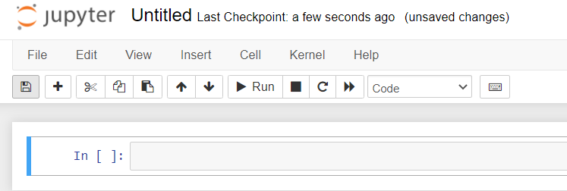
Jupyter notebooks
Click on one of the urls and create a new Notebook
Rename your Notebook to ‘Introduction pandas’

Slide 8
Install and import pandas
Run the install command in a terminal window:
pip install pandas
In Jupyter you must use a preceding ! to force the code cell to be executed in a terminal window: !pip install pandas
To import pandas we usually import it with a shorter name since it's used so much: import pandas as pd

Slide 9
About dirty data

Slide 10
Same data, different formats
country year cases population
<chr> <int> <int> <int>
1 Afghanistan 1999 745 19987071
2 Afghanistan 2000 2666 20595360
3 Brazil 1999 37737 172006362
4 Brazil 2000 80488 174504898
5 China 1999 212258 1272915272
6 China 2000 213766 1280428583
country year type count
<chr> <int> <chr> <int>
1 Afghanistan 1999 cases 745
2 Afghanistan 1999 population 19987071
3 Afghanistan 2000 cases 2666
4 Afghanistan 2000 population 20595360
5 Brazil 1999 cases 37737
6 Brazil 1999 population 172006362
7 Brazil 2000 cases 80488
8 Brazil 2000 population 174504898
9 China 1999 cases 212258
10 China 1999 population 1272915272
11 China 2000 cases 213766
12 China 2000 population 1280428583
country year rate
* <chr> <int> <chr>
1 Afghanistan 1999 745/19987071
2 Afghanistan 2000 2666/20595360
3 Brazil 1999 37737/172006362
4 Brazil 2000 80488/174504898
5 China 1999 212258/1272915272
6 China 2000 213766/1280428583
country `1999` `2000`
* <chr> <int> <int>
1 Afghanistan 19987071 20595360
2 Brazil 172006362 174504898
3 China 1272915272 1280428583
country `1999` `2000`
* <chr> <int> <int>
1 Afghanistan 745 2666
2 Brazil 37737 80488
3 China 212258 213766

Slide 11
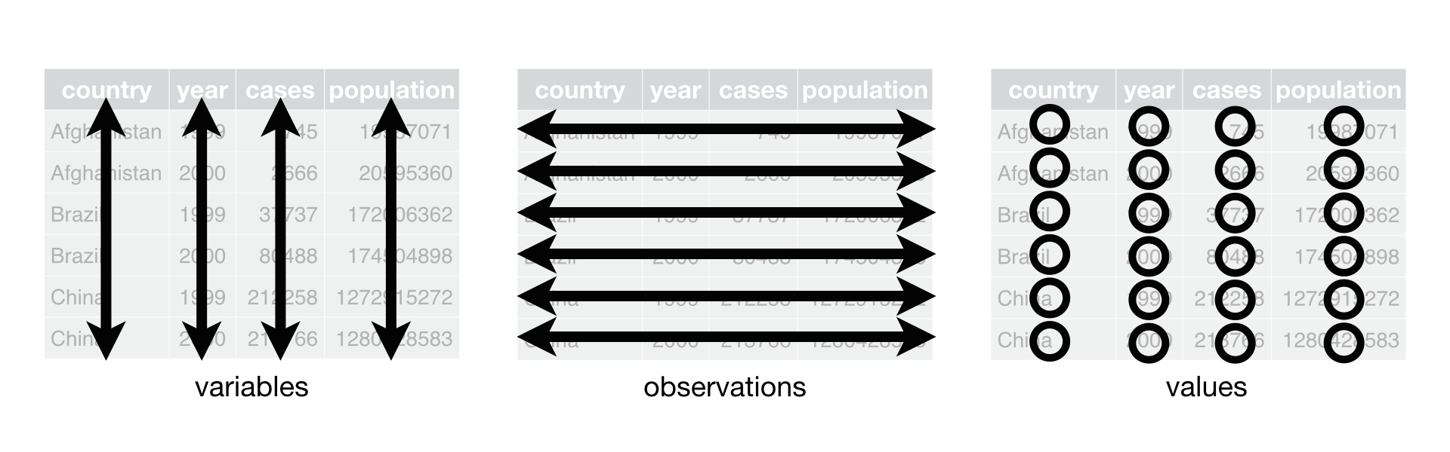
3 Rules
Each variable must have its own column.
Each observation must have its own row.
Each value must have its own cell.

Slide 12
Applying the rules
Each variable must have its own column
country year cases population
<chr> <int> <int> <int>
1 Afghanistan 1999 745 19987071
2 Afghanistan 2000 2666 20595360
3 Brazil 1999 37737 172006362
4 Brazil 2000 80488 174504898
5 China 1999 212258 1272915272
6 China 2000 213766 1280428583
country year type count
<chr> <int> <chr> <int>
1 Afghanistan 1999 cases 745
2 Afghanistan 1999 population 19987071
3 Afghanistan 2000 cases 2666
4 Afghanistan 2000 population 20595360
5 Brazil 1999 cases 37737
6 Brazil 1999 population 172006362
7 Brazil 2000 cases 80488
8 Brazil 2000 population 174504898
9 China 1999 cases 212258
10 China 1999 population 1272915272
11 China 2000 cases 213766
12 China 2000 population 1280428583
type and count are not variables, they are data types
country year rate
* <chr> <int> <chr>
1 Afghanistan 1999 745/19987071
2 Afghanistan 2000 2666/20595360
3 Brazil 1999 37737/172006362
4 Brazil 2000 80488/174504898
5 China 1999 212258/1272915272
6 China 2000 213766/1280428583
1999 and 2000 are not variables, they are values!
country `1999` `2000`
* <chr> <int> <int>
1 Afghanistan 19987071 20595360
2 Brazil 172006362 174504898
3 China 1272915272 1280428583
country `1999` `2000`
* <chr> <int> <int>
1 Afghanistan 745 2666
2 Brazil 37737 80488
3 China 212258 213766
One column contains two variables

Slide 13
Applying the rules
Each observation must have its own row
country year cases population
<chr> <int> <int> <int>
1 Afghanistan 1999 745 19987071
2 Afghanistan 2000 2666 20595360
3 Brazil 1999 37737 172006362
4 Brazil 2000 80488 174504898
5 China 1999 212258 1272915272
6 China 2000 213766 1280428583
country year type count
<chr> <int> <chr> <int>
1 Afghanistan 1999 cases 745
2 Afghanistan 1999 population 19987071
3 Afghanistan 2000 cases 2666
4 Afghanistan 2000 population 20595360
5 Brazil 1999 cases 37737
6 Brazil 1999 population 172006362
7 Brazil 2000 cases 80488
8 Brazil 2000 population 174504898
9 China 1999 cases 212258
10 China 1999 population 1272915272
11 China 2000 cases 213766
12 China 2000 population 1280428583
two rows per observation
country year rate
* <chr> <int> <chr>
1 Afghanistan 1999 745/19987071
2 Afghanistan 2000 2666/20595360
3 Brazil 1999 37737/172006362
4 Brazil 2000 80488/174504898
5 China 1999 212258/1272915272
6 China 2000 213766/1280428583
Observations spread across two tables
country `1999` `2000`
* <chr> <int> <int>
1 Afghanistan 19987071 20595360
2 Brazil 172006362 174504898
3 China 1272915272 1280428583
country `1999` `2000`
* <chr> <int> <int>
1 Afghanistan 745 2666
2 Brazil 37737 80488
3 China 212258 213766

Slide 14
Applying the rules
Each value must have its own cell
country year cases population
<chr> <int> <int> <int>
1 Afghanistan 1999 745 19987071
2 Afghanistan 2000 2666 20595360
3 Brazil 1999 37737 172006362
4 Brazil 2000 80488 174504898
5 China 1999 212258 1272915272
6 China 2000 213766 1280428583
country year type count
<chr> <int> <chr> <int>
1 Afghanistan 1999 cases 745
2 Afghanistan 1999 population 19987071
3 Afghanistan 2000 cases 2666
4 Afghanistan 2000 population 20595360
5 Brazil 1999 cases 37737
6 Brazil 1999 population 172006362
7 Brazil 2000 cases 80488
8 Brazil 2000 population 174504898
9 China 1999 cases 212258
10 China 1999 population 1272915272
11 China 2000 cases 213766
12 China 2000 population 1280428583
country year rate
* <chr> <int> <chr>
1 Afghanistan 1999 745/19987071
2 Afghanistan 2000 2666/20595360
3 Brazil 1999 37737/172006362
4 Brazil 2000 80488/174504898
5 China 1999 212258/1272915272
6 China 2000 213766/1280428583
country `1999` `2000`
* <chr> <int> <int>
1 Afghanistan 19987071 20595360
2 Brazil 172006362 174504898
3 China 1272915272 1280428583
country `1999` `2000`
* <chr> <int> <int>
1 Afghanistan 745 2666
2 Brazil 37737 80488
3 China 212258 213766
One cell contains two values

Slide 15
About boxplots and data skewing

Slide 16
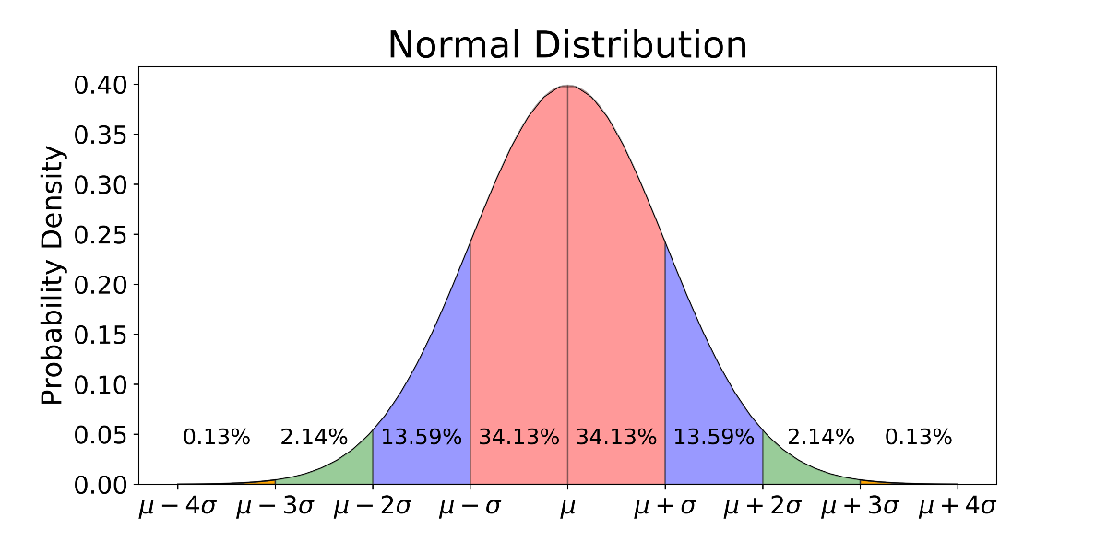
Normal distribution
Most data will have a “normal” distribution
This means:
A lot of datapoints in the center (red part)
Some datapoints to the side (blue part)
Leftovers left and right (green and ... part)
Standard deviation is a measure for the width of the curve
Notes:
https://towardsdatascience.com/understanding-the-68-95-99-7-rule-for-a-normal-distribution-b7b7cbf760c2

Slide 17
Normal distribution in boxplot
A normal distribution is a plot of 1 variable, with varying bin width
But if the data is perfectly normal the bin width won’t show you that much
Which is nice, but doesn’t compare
Prices of fiction vs prices of non-fiction books
So we need a more compact way of showing a distribution
Enter: The Boxplot
Notes:
https://www.r-graph-gallery.com/boxplot.html

Slide 18
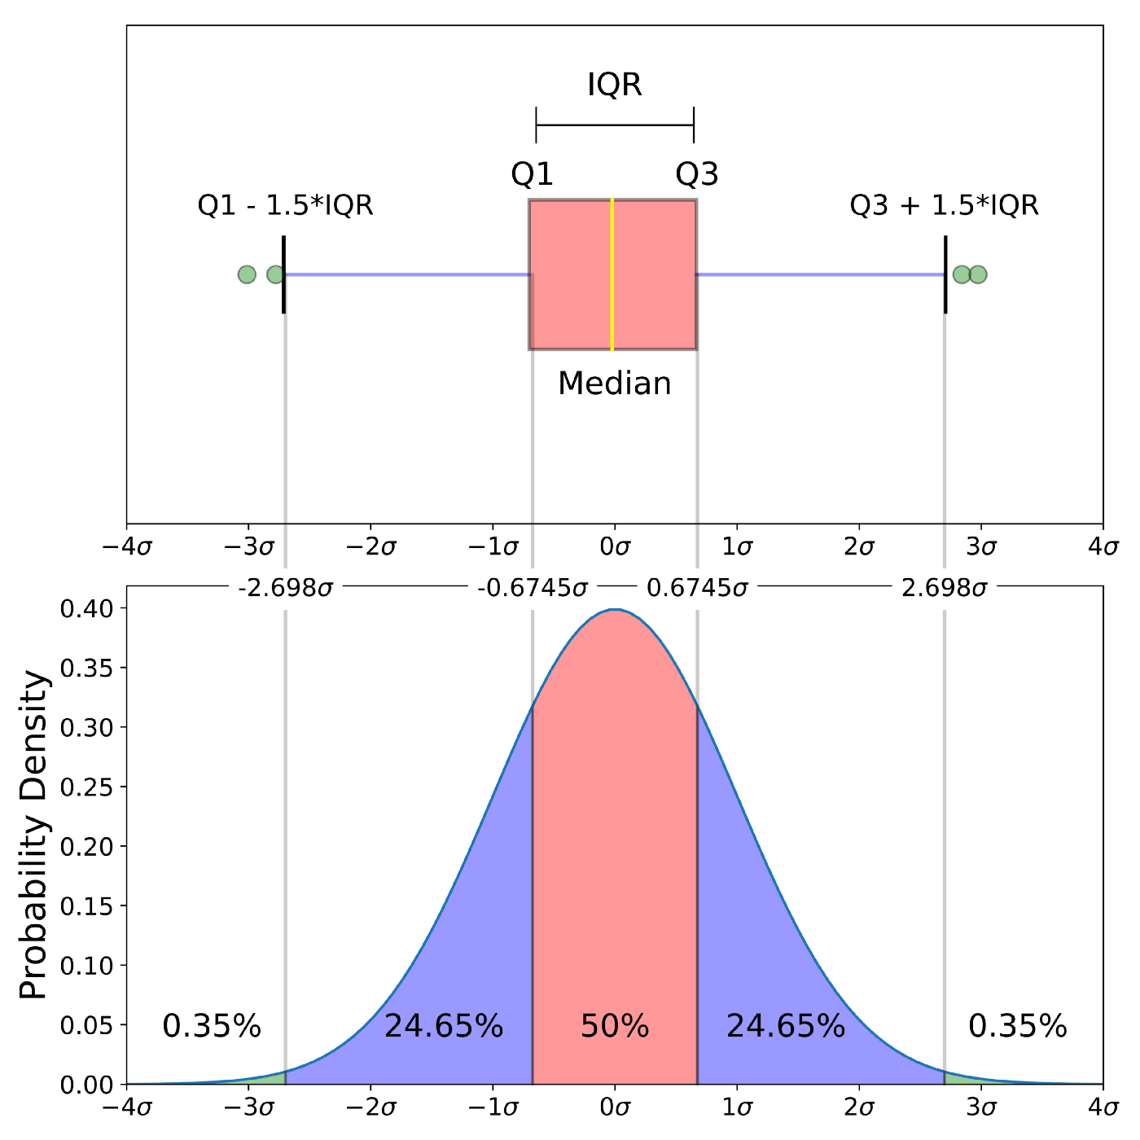
The middle line: the center of the bell-curve
The box: the red part
The lines: the blue part
The dots: the green part
Notes:
https://towardsdatascience.com/understanding-boxplots-5e2df7bcbd51

Slide 19
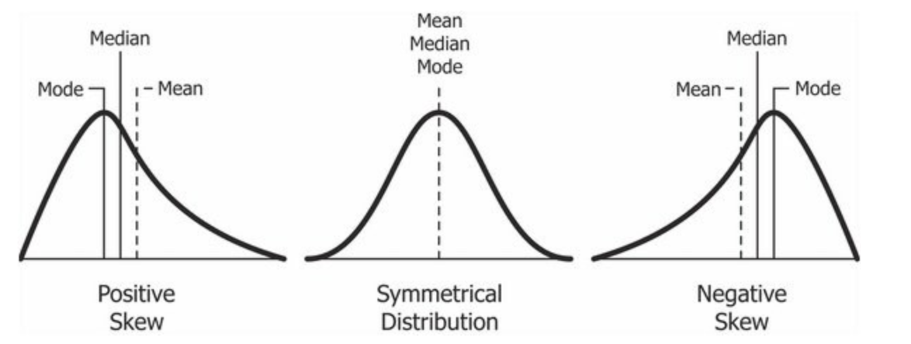
Dataset skewing
All data is ‘normal’, but some is more normal than others
Notes:
https://en.wikipedia.org/wiki/Skewness

Slide 20
Negative skew
Distribution of Age of Deaths
The distribution of the age of deaths in most populations is negatively skewed. Most people live to be between 70 and 80 years old, with fewer and fewer living less than this age.
Distribution of Olympic Long Jumps
In most years, the distribution of long jump lengths for competitors in the Olympics is negatively skewed because most competitors land a jump around 7.5-8 meters, with a few landing a jump of just 5-6 meters.
Distribution of Scores on Easy Exams
The distribution of scores on easy exams or tests tend to be negatively skewed because most students score very high, while a few students score much lower than the average.
Notes:
https://www.statology.org/negatively-skewed-distribution-examples/

Slide 21
Positive skew
Distribution of Income
The distribution of individual incomes in the U.S. is right-skewed, with most individuals earning between $20k and $40k per year but with a long right tail of households that earn much more.
Distribution of Pet Ownership
The distribution of the number of pets that households own in any particular city is likely to be right skewed because most households have either 0 or 1 pet, but there are many outlier households that have 7, 8, 9+ pets that cause the distribution to be right skewed.
Distribution of Scores on a Difficult Exam
The distribution of scores on any particularly difficult exam will be positively skewed with most students scoring around some mean value with a few outlier students scoring much higher.
Notes:
https://www.statology.org/positively-skewed-distribution-examples/

Slide 22
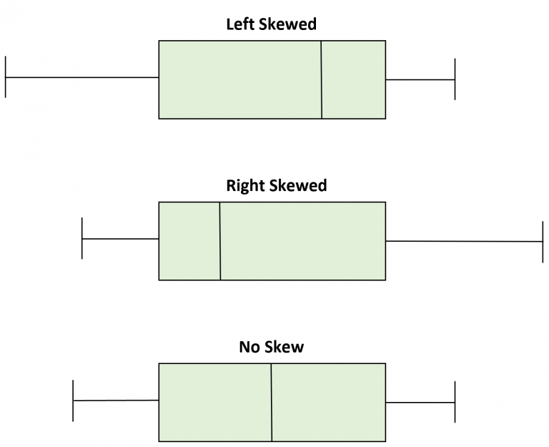
Boxplot skewing
How does a boxplot show skewing?
The middle line is always the center of your data
If that is a perfect mirror-line, your data is perfectly symmetrical and perfectly normal
But if the box is smaller on one side of the line, the data is “steeper” there
Less different values, but they occur more
Usually a small box on one side also means a shorter line

Slide 23
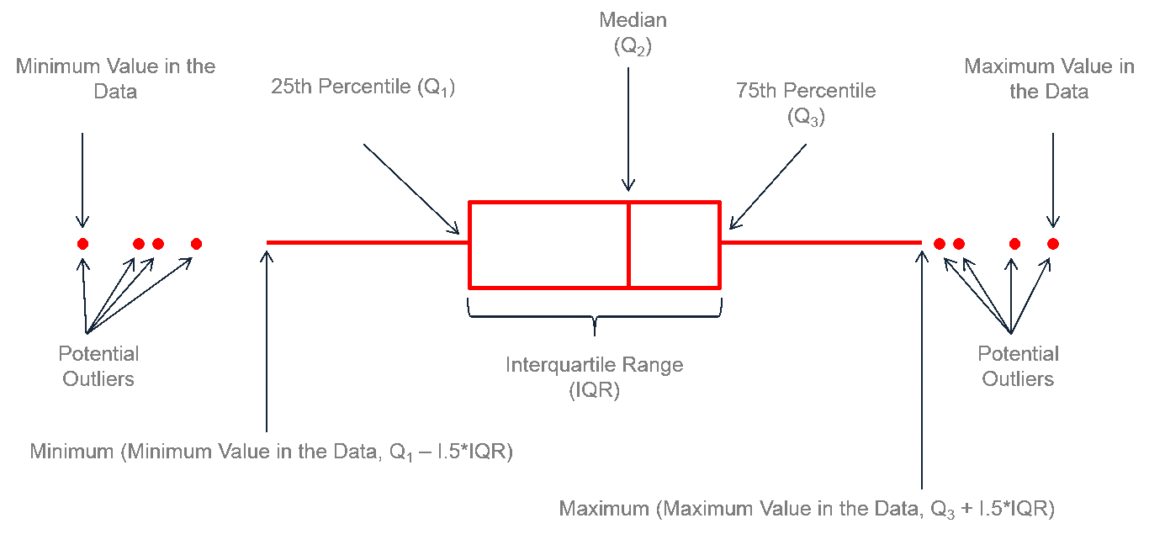
The boxplot in R
Notes:
https://www.r-graph-gallery.com/boxplot.html

Slide 24
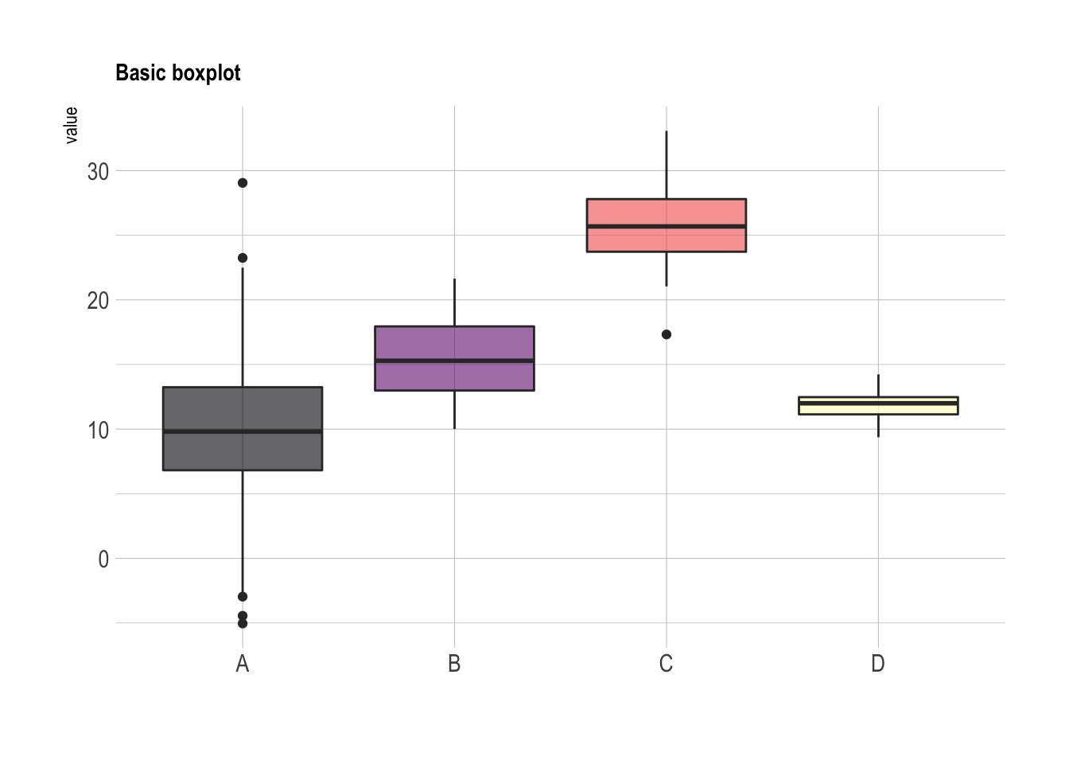
Basic boxplot
Compare the distribution of 4 categories
1 variable
In 4 categories
You see how
A is very spread out (unsteep bell curve)
D is very compact (pointy bell curve)
All are pretty ‘normal’

Slide 25
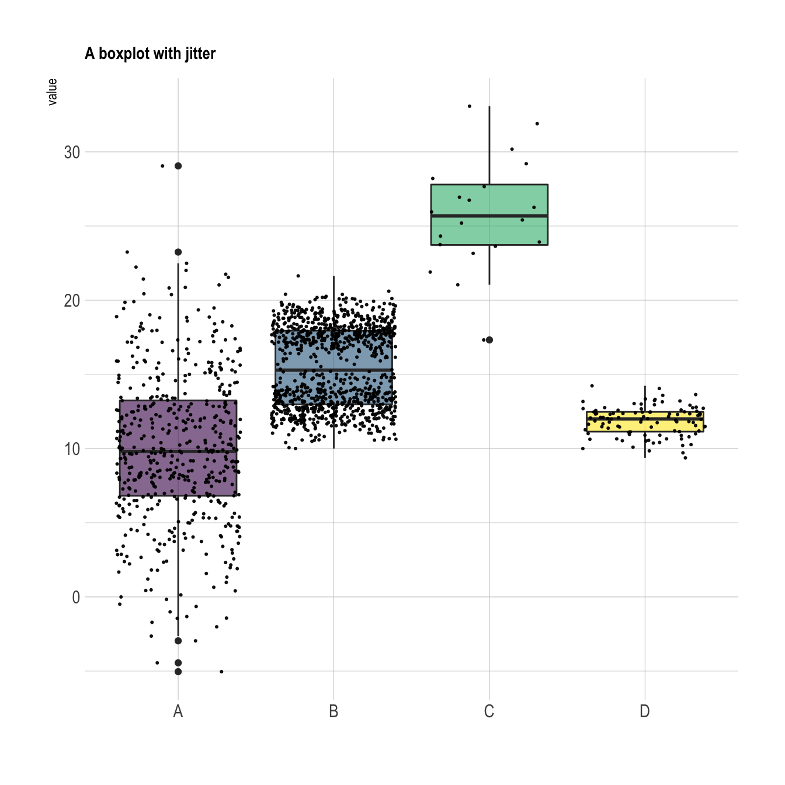
Advanced boxplot
You see all of the above and:
C doesn’t have a lot of datapoints
B has two peaks

Slide 26
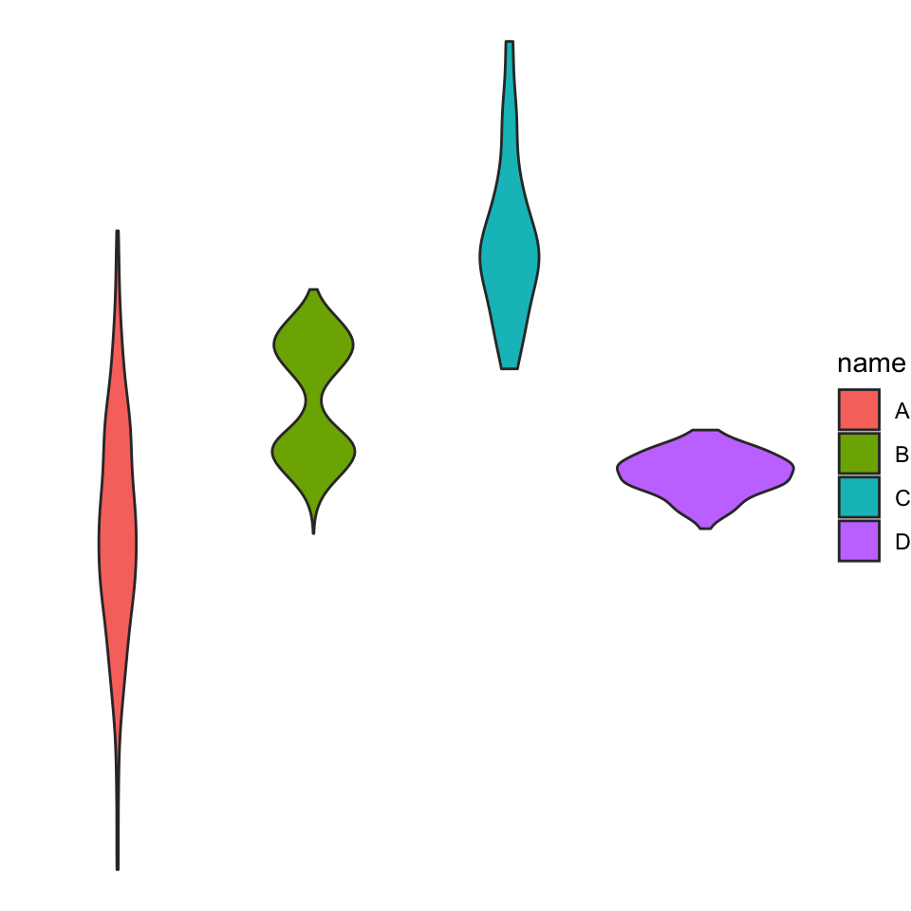
Violin plot
Comparable to a boxplot, but the numbers are no longer there
Prettier, but not always better
Is better for B though…

Slide 27
Using pandas

Slide 28
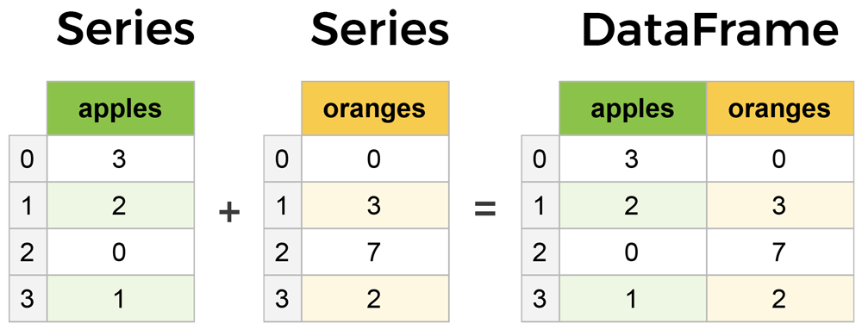
Core components of pandas: Series & DataFrame
A Series is essentially a column
A DataFrame is a multi-dimensional table made up of a collection of Series

Slide 29
Creating DataFrames from scratch
There are many ways to create a DataFrame from scratch, but a great option is to use a simple dictionary.
Let's say we have a fruit stand that sells apples and oranges. We want to have a column for each fruit and a row for each customer purchase. Organized as a dictionary this looks like:
The data dictionary counts 2 key-value pairs
Keys: apples + oranges Values: lists with the corresponding purchases
data = {
'apples': [3, 2, 0, 1],
'oranges': [0, 3, 7, 2]
}

Slide 30
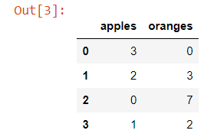
Creating DataFrames from scratch
Next the dictionary can be passed to the DataFrame constructor
Each (key, value) pair in the dictionary now corresponds to a column in the resulting DataFrame. The Index of this DataFrame was given to us on creation as the numbers 0-3.
purchases = pd.DataFrame(data) purchases

Slide 31
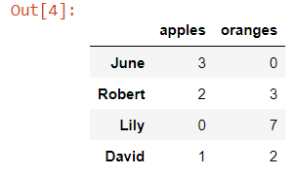

Creating DataFrames from scratch
Instead of the default numeric indexing, each row can get a custom index label: e.g. customer names
A datarow of a specific customer can then be located based on their name
purchases = pd.DataFrame(data, index=['June', 'Robert', 'Lily', 'David'])
purchases
purchases = purchases.loc[ 'Lily’]
To extract rows based on the index label, you use .loc[‘label’]

Slide 32
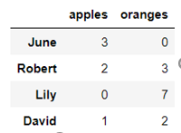

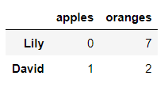
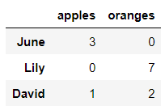
Extracting data
A datarow can also be extracted based on index number with iloc[index]
By specifying a list of indexes multiple rows are retrieved
purchases = purchases.iloc[2]
purchases = purchases.iloc[[2,3]]
purchases = purchases.iloc[[0,2,3]]

Slide 33
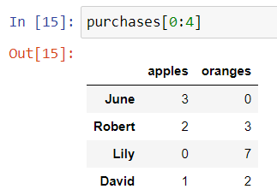
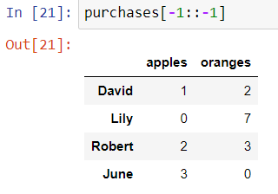
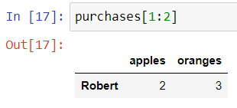
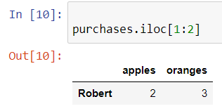
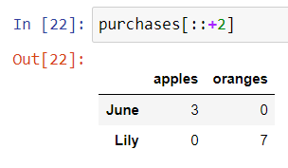
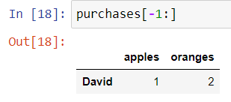
Extracting data
Extracting rows from a DataFrame can also be done by slicing

Slide 34
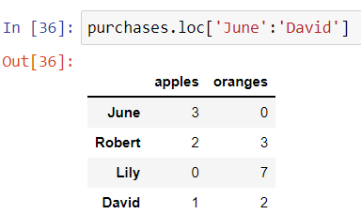
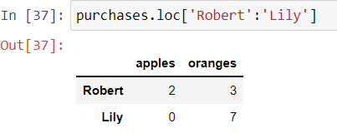
Extracting data
Slicing works with index labels
Note that if using labels (loc) the end-element is included in the result, which is not true in case of normal index-based slicing (iloc)

Slide 35

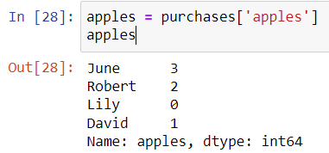
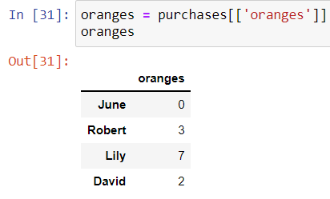
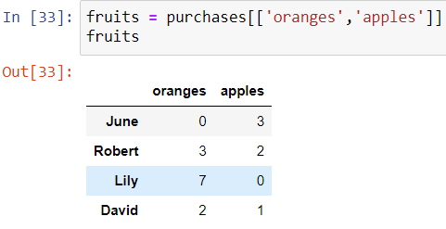


Extracting data
Extracting 1 column from a dataframe results in a Series
To extract columns as a DataFrame, you need to pass a list[] of column names
Note that purchases.apples will also work

Slide 36
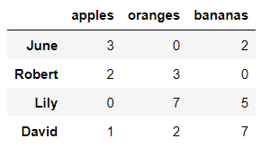
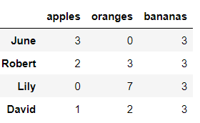
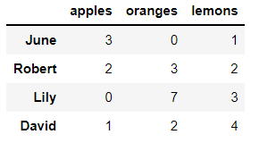
Assigning data
Going the other way, assigning data to a DataFrame is easy.
You can insert/update a column with either:
a constant value:
or an iterable of values:
purchases['bananas']=3
purchases['bananas’]=[2,0,5,7]
purchases['lemons'] = range(1,len(purchases)+1,+1)

Slide 37
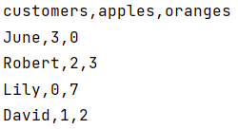
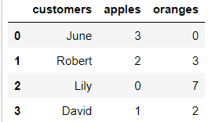
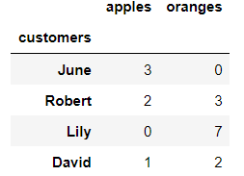
Reading data from CSVs
With CSV files all you need is a single line to load in the data:
CSVs don't have indexes like our DataFrames, so you need to designate the index_col when reading:
df = pd.read_csv('purchases.csv')
df = pd.read_csv('purchases.csv', index_col=0)

Slide 38
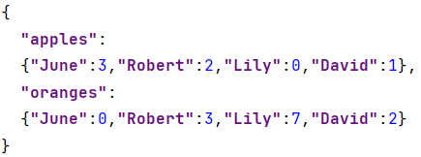
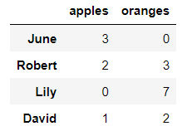
Reading data from JSON
If you have a JSON file pandas can read this just as easily.
Notice this time the index came correctly since JSON allows indexes to work through nesting.
JSON isn't a tabular format. When pandas cannot deduce the JSON structure, set the orient parameter. (https://www.roelpeters.be/pandas-read-json-orient)
df = pd.read_json('purchases.json')
Notes:
https://www.roelpeters.be/pandas-read-json-orient/

Slide 39
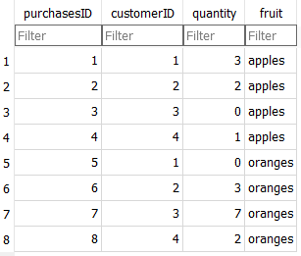
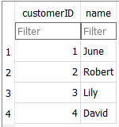
Reading data from databases
You can use any database, but we’ll be using SQLite
No installation required, the entire database is contained in a file that you can open using portable software
https://sqlitebrowser.org/
We’re using 2 tables and yes, that is badly normalized

Slide 40
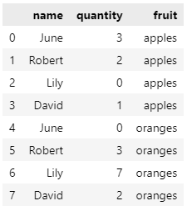
Reading data from databases
import sqlite3
con = sqlite3.connect("purchases.db")
df = pd.read_sql_query("SELECT c.name, p.quantity, p.fruit FROM customers c join purchases p on c.customerID = p.customerID", con)
df
The resulting dataframe is different from what we got from a CSV-file
That’s because of how normalized data works
We could fix this using the techniques that follow in this and the next chapter
But for now it’s a good enough proof of concept

Slide 41
Storing dataframe in CSV or JSON
After extensive work on cleaning data in a DataFrame, the result can be saved as a file of your choice.
Similar to the ways we read in data, pandas provides intuitive commands to save it:
df.to_csv('new_purchases.csv')
df.to_json('new_purchases.json’)
df.to_excel('new_purchases.xlsx’)

Slide 42
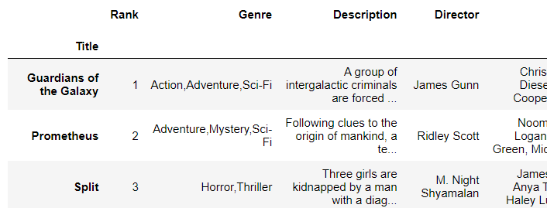
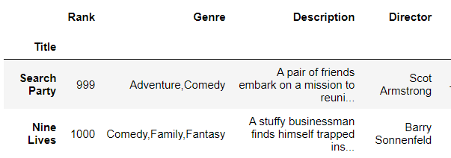
Basic DataFrame operations
Load in the IMDB movies dataset from csv designating the movie titles to be our index.
To get an overview of the first or last records in the DataFrame, use the head() or tail() methods. Both accept a number as argument to indicate how many records should be retrieved.
df_movies = pd.read_csv("IMDB-Movie-Data.csv", index_col="Title")
df_movies.head(3)
df_movies.tail(2)

Slide 43
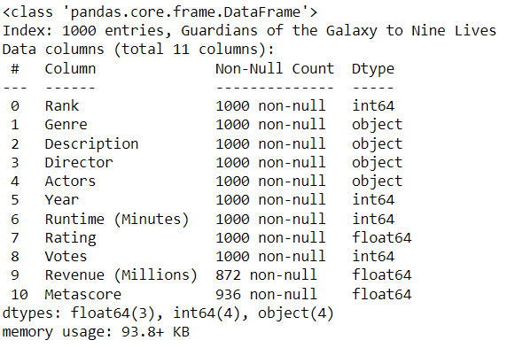
Getting info about the data
The method .info() provides the essential details about the dataset, such as the number of rows and columns, the number of non-null values, what type of data is in each column, and how much memory the DataFrame is using.
df_movies.info()
The dataframe counts 1000 rows and 11 columns This information can also be retrieved with the property shape.
df_movies.shape
Missing values!

Slide 44


Column names cleanup
Best practice for column names is to lowercase them, remove special characters, and replace spaces with underscores
Here's how to get the column names of our dataset:
Use the .rename() method to rename certain or all columns via a dictionary.
df_movies.columns
df_movies.rename(columns={
'Runtime (Minutes)': 'Runtime',
'Revenue (Millions)': 'Revenue_millions'
}, inplace=True)
Inplace = true is an alternative way to code df_movies = movies.df.rename(….)

Slide 45

Column names cleanup
You can also set the columns property to a list of appropriate names:
The above solution is a long way to lowercase each column. Instead of just renaming each column manually we can do a list comprehension:
df_movies.columns = ['rank', 'genre', 'description', 'director', 'actors', 'year', 'runtime',
'rating', 'votes', 'revenue_millions', 'metascore']
df_movies.columns = [col.lower() for col in df_movies]

Slide 46
Missing values
When exploring data, you’ll most likely encounter missing or null values, which are essentially placeholders for non-existent values.
Most commonly you'll see Python's None or NumPy's np.nan
There are two options in dealing with nulls:
Get rid of rows or columns with nulls
Replace nulls with non-null values, a technique known as imputation
Data Scientists regularly face the dilemma of dropping or imputing null values. This decision requires profound knowledge of the data and its context. Overall, removing null data is only suggested if you have a small amount of missing data.

Slide 47
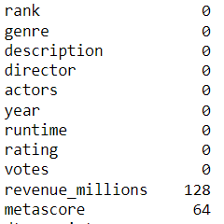
Missing values
.isnull() returns for every data cell whether a value is present.
To count the number of nulls in each column use an aggregate function for summing.
df_movies.isnull().sum()
We can see now that our data has 128 missing values for revenue_millions and 64 missing values for metascore.

Slide 48

Missing values: remove rows or columns
Remove rows with missing elements:
162 rows are deleted with missing revenue_millions and/or metascore
This obviously seems like a waste since there's perfectly good data in the other columns of those dropped rows
Other than just dropping rows, you can also drop columns with null values by setting the parameter axis=1:
Now the columns revenue_millions and metascore are gone
df_movies.dropna(inplace=True) df_movies. shape
df_movies.dropna(axis = 1, inplace=True) df_movies. shape

Slide 49
What's with this axis=1 parameter?
It's not immediately obvious where axis comes from and why is must be 1 to affect columns. To understand, just look at the .shape output:
This is a tuple that represents the shape of the DataFrame, i.e. 1000 rows and 11 columns. Note that the rows are at index 0 of this tuple and columns are at index 1.
Therefore axis=1 affects columns. This comes from NumPy, and is a great example of why learning NumPy is worth your time.
df_movies.shape

Slide 50
Missing values: imputation
Imputation is a conventional technique used to keep valuable data that have null values.
There may be instances where dropping every row with a null value removes too big a chunk from your dataset, so instead we can impute that null with another value, usually the mean or the median of that column.

Slide 51
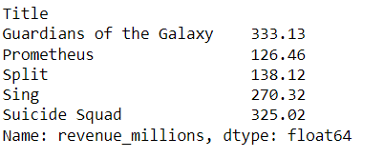
Missing values: imputation
Let's look at imputing the missing values in the revenue_millions column. First extract that column into its own variable:
revenue now contains a Series:
revenue = df_movies['revenue_millions']
revenue.head()

Slide 52

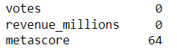
Missing values: imputation
Impute the missing values of revenue using the mean.
First calculate the mean value:
Next fill the nulls using .fillna() :
revenue_mean = revenue.mean()
revenue_mean
revenue.fillna(revenue_mean, inplace=True)
We have now replaced all nulls in revenue with the mean of the column.
Notice that by using inplace=True we have actually affected the original df_movies and not only the series.
df_movies.isnull().sum()

Slide 53
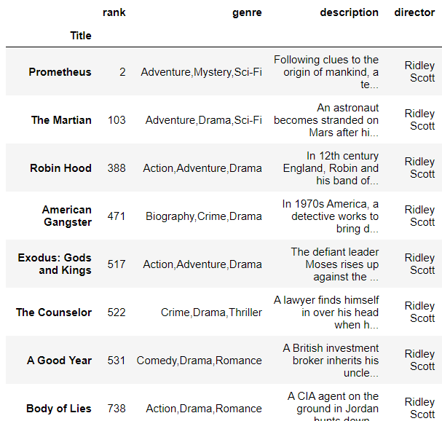
Conditional selections
We’ve gone over how to select columns and rows, but what if we want to make a conditional selection?
For example, what if we want to filter our movies DataFrame to show only films directed by Ridley Scott?
df_movies[df_movies['director'] == "Ridley Scott"]
This instruction can be read as SQL: Select df_movies where df_movies director equals Ridley Scott.

Slide 54
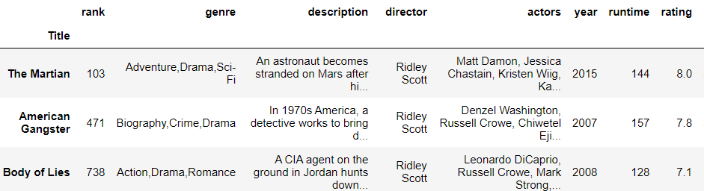
Conditional selections
Conditions can be combined by using logical operators:
| for "or"
& for "and“
Each condition is written between ()
E.g. movies directed by Ridley Scott with a rating above 7.0
df_movies[(df_movies['director'] == "Ridley Scott") & (df_movies[‘rating’] > 7.0 ) ]

Slide 55
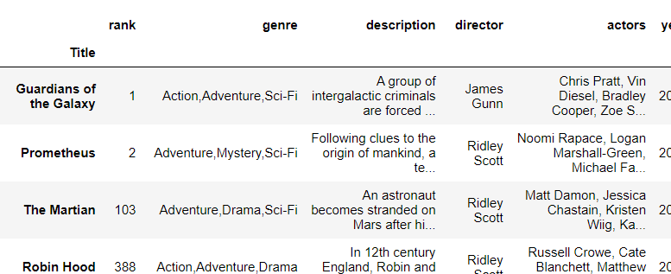
Conditional selections
Frequently used in selection making is the isin() method (~ OR)
E.g. movies directed by Ridley Scott OR James Gunn
df_movies[df_movies['director'].isin(['Ridley Scott’,'James Gunn’] )]

Slide 56
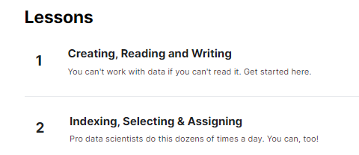

Exercises
Kaggle course Pandas: https://www.kaggle.com/learn/pandas
Make the exercises from lessons 1 - 2 - 5

Slide 57
Resources
https://www.learndatasci.com/tutorials/python-pandas-tutorial-complete-introduction-for-beginners/
https://pandas.pydata.org/Pandas_Cheat_Sheet.pdf

